Slide 1
Digital Portfolio
STUDENT NAME: SABITHRA I
REGISTER NO AND NMID: 212401026/7A35897E648C8F3982F42AD8270CB391
DEPARTMENT: COMPUTER APPLICATION
COLLEGE: UNIVERSITY OF MADRAS

Slide 2
PROJECT TITLE
DIGITAL PORTFOLIO

Slide 3


AGENDA
Problem Statement
Project Overview
End Users
Tools and Technologies
Portfolio design and Layout
Features and Functionality
Results and Screenshots
Conclusion
Github Link
3/21/2024 Annual Review

Slide 4

PROBLEM STATEMENT
In today’s competitive environment, individuals struggle to showcase their skills, achievements, and projects in an organized and professional way. Traditional resumes provide limited space and fail to visually represent one’s abilities. To solve this, a digital portfolio is required to highlight technical skills, creativity, and accomplishments in a structured, accessible, and interactive manner.

Slide 5

PROJECT OVERVIEW
In the current job market, resumes alone are not enough to showcase an individual’s complete potential. Employers and recruiters need a clear, accessible, and engaging way to understand a candidate’s background, skills, and education. Many students face challenges in effectively presenting their achievements in a structured format. To solve this problem, a digital portfolio is developed to provide a professional platform that highlights personal details, technical skills, and educational qualifications in an organized and visually appealing manner.

Slide 6

WHO ARE THE END USERS?
The end users of this digital portfolio include recruiters and employers who seek to evaluate a candidate’s skills, education, and overall profile during the hiring process. Academic institutions and faculty members may also use it to review academic achievements and project work. In addition, potential clients can explore the portfolio to understand the individual’s capabilities before offering freelance or project-based opportunities. Peers and professional networks may access the portfolio for collaboration and knowledge sharing. Finally, the portfolio also serves as a self-assessment tool for the owner, enabling personal growth and professional representation.

Slide 7

TOOLS AND TECHNIQUES
The development of the digital portfolio makes use of various tools and techniques to ensure a structured, user-friendly, and visually appealing design. The primary tools include HTML for creating the structure of web pages, CSS for styling and layout design, and JavaScript for adding interactivity. In addition, text editors such as Visual Studio Code are used for coding and project management. Techniques such as responsive web design are applied to ensure compatibility across devices, while version control with GitHub can be used for maintaining and updating the project. Together, these tools and techniques enable the creation of an organized, interactive, and professional portfolio that effectively showcases personal information, skills, and educational qualifications.

Slide 8
POTFOLIO DESIGN AND LAYOUT
The layout and design of the digital portfolio are structured to provide a clean, professional, and user-friendly interface. The homepage introduces the individual through an About Me section, followed by clearly organized sections on Skills and Education. A simple navigation menu is included to allow easy access to different parts of the portfolio. The design follows a minimalistic and responsive approach, ensuring compatibility across desktops, tablets, and mobile devices. Consistent use of colors, typography, and spacing enhances readability, while visual elements such as icons or dividers improve presentation. The overall design focuses on clarity, accessibility, and professionalism to leave a strong impression on the end users.
8

Slide 9
FEATURES AND FUNCTIONALITY
The digital portfolio is designed with features and functionalities that enhance both presentation and usability. It includes an About Me section to provide a brief introduction and personal background, a Skills section to highlight technical and professional abilities, and an Education section to showcase academic qualifications. The portfolio is built with a responsive design, ensuring smooth accessibility across different devices such as laptops, tablets, and smartphones. A navigation menu allows users to move easily between sections, while the clean layout ensures readability and professional presentation. Additional functionality such as interactive elements, clickable links, and organized content structure make the portfolio not only informative but also engaging for recruiters, peers, and other end users.

Slide 10
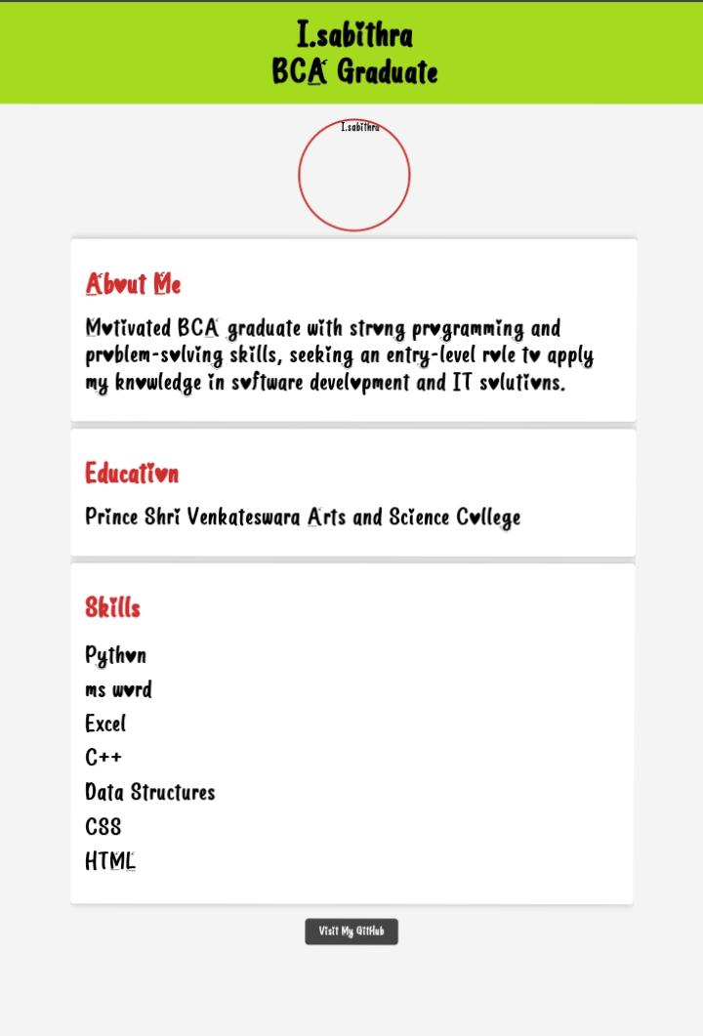

RESULTS AND SCREENSHOTS
The digital portfolio was successfully developed to showcase personal details, skills, and education in a professional format. The screenshots below display the final layout and design of the project.
3/21/2024 Annual Review
10

Slide 11
CONCLUSION
It showcases personal details, skills, and education in a structured format.The layout is clean, user-friendly, and responsive across devices.It serves as a professional tool for academic and career opportunities.
11

Slide 12
GITHUB LINK
https://sabithra-arch.github.io/Sabithra-I/

